Slide 1


模拟电子技术基础
Analog Device
5 Frequency response of amplifier circuits 放大电路的频率响应
陈晓龙 Chen, Xiaolong
Department of Electrical and Electronic Engineering

Slide 2
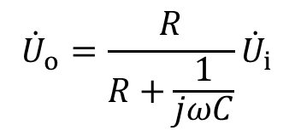


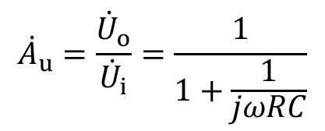
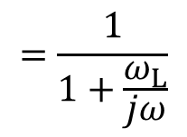
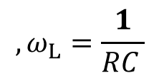

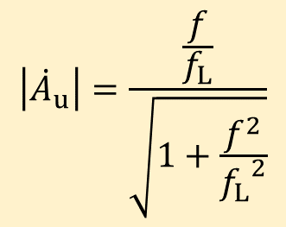
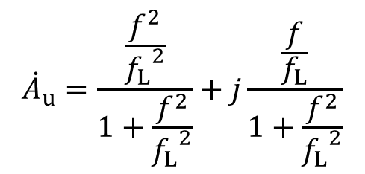
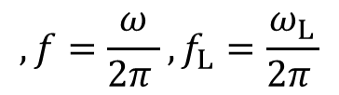
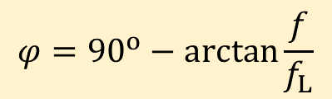
5.1 Fundamental of frequency response
High frequency pass circuit 高通电路
+
+
C
R
-
-

Slide 3




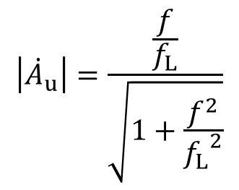




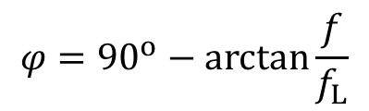



High frequency pass circuit 高通电路
+
+
C
Stop band
R
-
-
Pass band
Amplitude frequency characteristic
幅频特性
Phase
Lower cut-off frequency
Phase frequency characteristic
相频特性

Slide 4
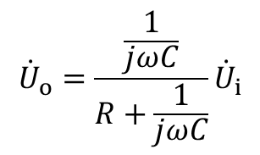

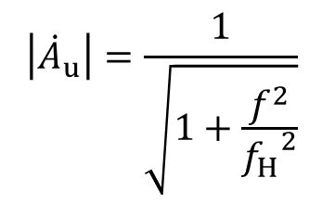

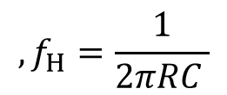




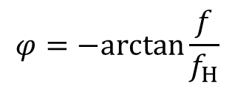

Low frequency pass circuit 低通电路
+
R
+
C
-
-
Pass band
Stop band
Amplitude frequency characteristic
幅频特性
Phase
Upper cut-off frequency
Phase frequency characteristic
相频特性

Slide 5
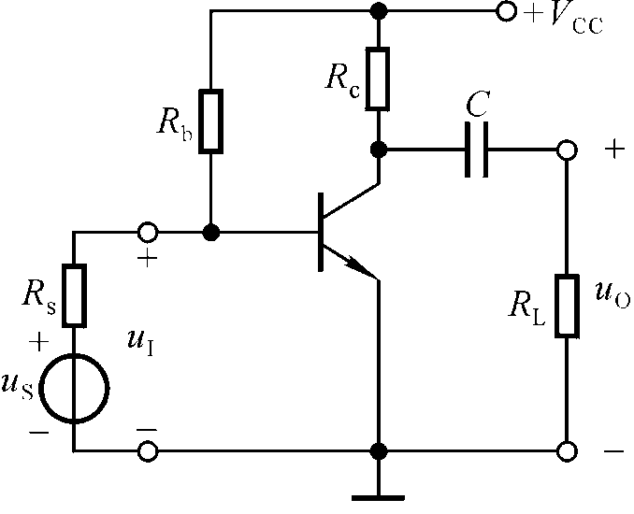








Bandwidth in amplifier circuit
High-f pass
Low-f pass
c
b
e
BE junction capacitor 结电容

Slide 6










































5.2 The high frequency model of transistor
Hybrid - π model 混合π模型
b
b’
c
c
c’
e
b’
b
b
b’
c
e’
e
e

Slide 7



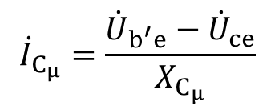
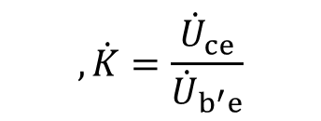






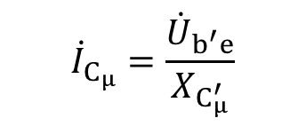







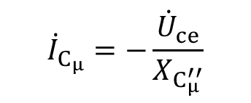
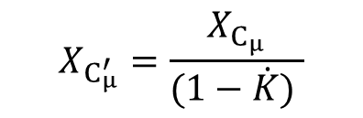



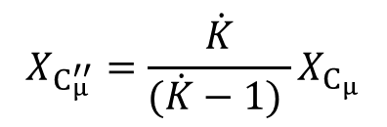

















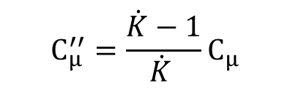
Unilateralization of hybrid - π model 混合π模型单向化
b
b’
c
e
b
b’
c
e

Slide 8





Unilateralization of hybrid - π model 混合π模型单向化
b
b’
c
e
Signal flow direction
Signal flow direction
b
b’
c
b
b’
c
e
e

Slide 9










Simplified hybrid - π model 简化混合π模型
b
b’
c
e
b
b’
c
e

Slide 10








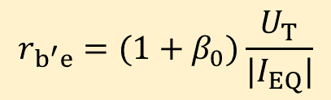





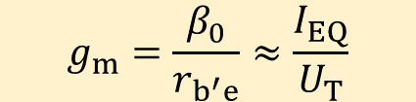


Simplified hybrid - π model
b
b’
c
e

Slide 11



















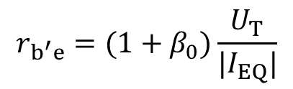
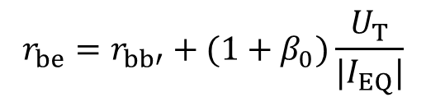

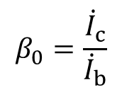
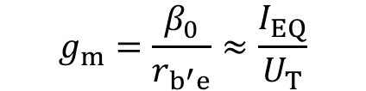

Simplified hybrid - π model
Simplified h-model
b
b’
c
b
c
e
e

Slide 12


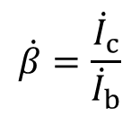








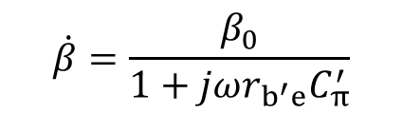

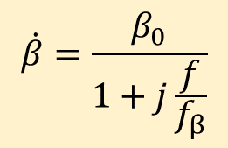
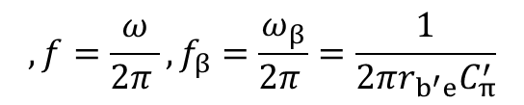
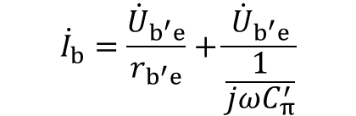

5.3 Current amplification factor at high frequency
The current amplification factor is defined as
b
b’
c
e
共射截止频率

Slide 13

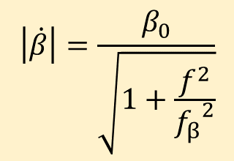


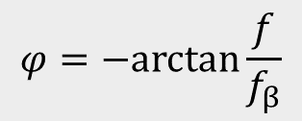



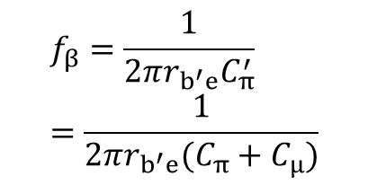



Slide 14




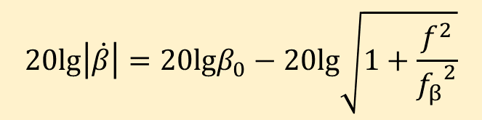






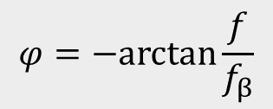



-20dB/十倍频
Use dB 分贝
3 dB
20 dB

Slide 15
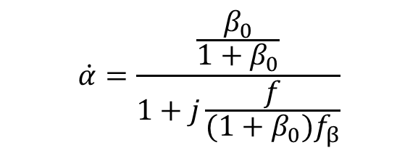
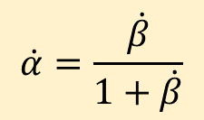
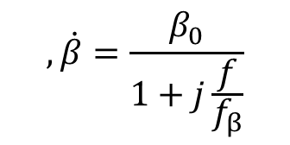
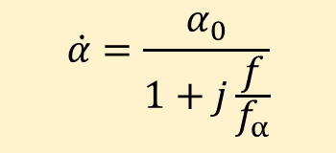

Common-b cut-off frequency 共基极截止频率
Common-b amplifier are more suitable for high frequency amplifier circuit

Slide 16







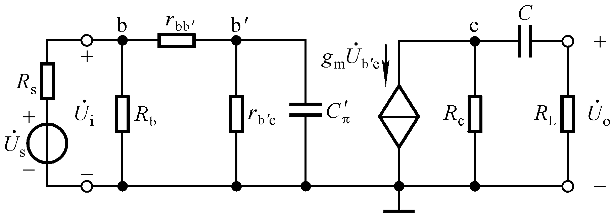
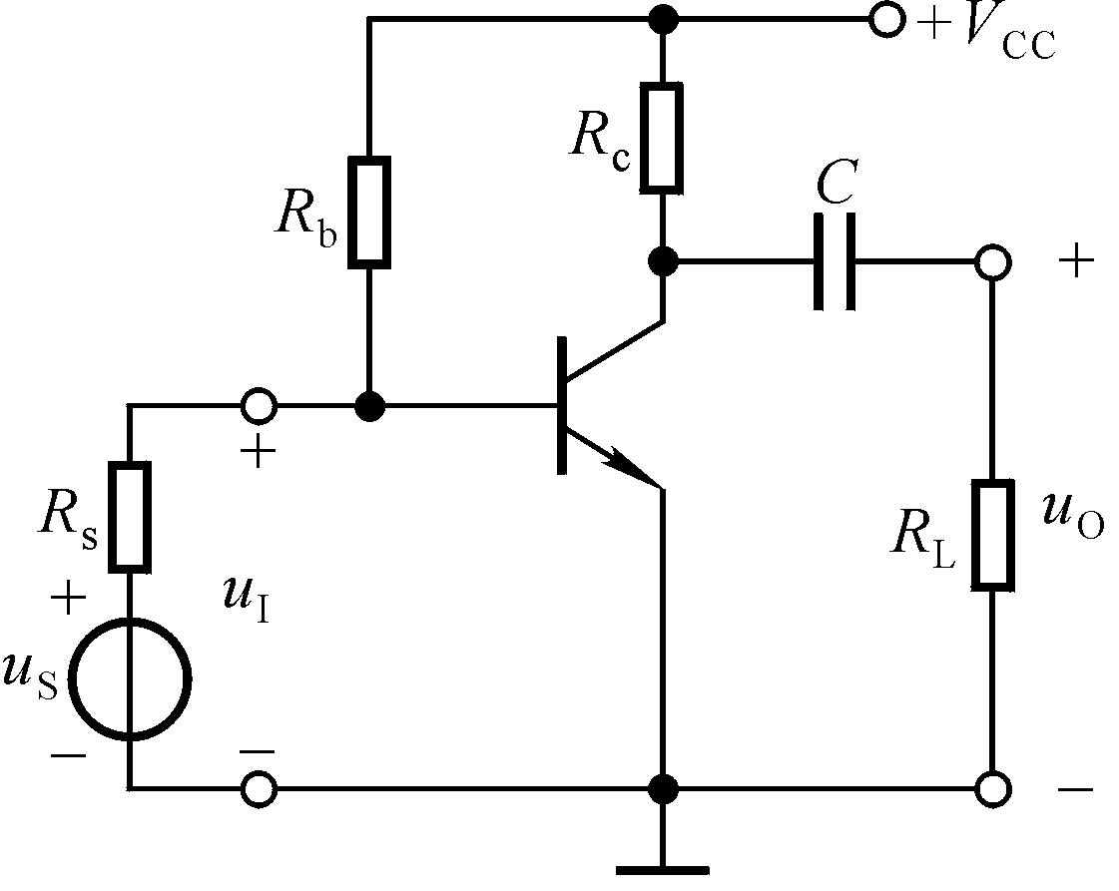
5.4 Frequency response of amplifier circuit
Low frequency pass circuit
High frequency pass circuit
Low-frequency band
Midband
High-frequency band
低频带
中频带
高频带

Slide 17
Low frequency pass circuit
High frequency pass circuit

Slide 18
















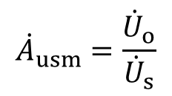
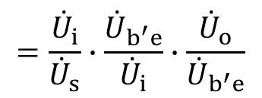
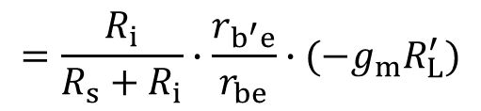


b
b’
c
e

Slide 19




























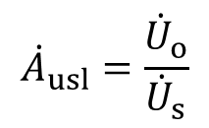
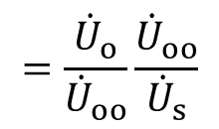











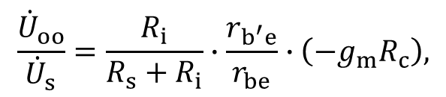

b
b’
c
Equivalent circuit
c
e
b
b’
c
e

Slide 20














b
b’
c
c
e

Slide 21






b
b’
c
c
e

Slide 22




b
b’
c
c
e
High pass

Slide 23












Low frequency: Amplitude and phase frequency characteristics
20dB/dec十倍频
3 dB
20 dB

Slide 24



























b
b’
c
e
b
b’
Equivalent circuit
b’
c
e
e

Slide 25








b
b’
b
b’
e
e

Slide 26


















Equivalent circuit
b’
c
e

Slide 27








Equivalent circuit
b’
c
e

Slide 28






b
b’
c
e
Low pass

Slide 29










High frequency: Amplitude and phase frequency characteristics
-20dB/十倍频
3 dB
20 dB

Slide 30















Full band: frequency response
3 dB
20 dB
High pass
Low pass
Bandwidth

Slide 31
















Bandwidth gain product: 带宽增益积
Bandwidth
Voltage gain
3 dB
20 dB
When gain increases, bandwidth decreases; When gain decreases, bandwidth increases.

Slide 32








Bandwidth gain product: 带宽增益积

Slide 33

Bandwidth gain product: 带宽增益积
When amplifier is fixed, the bandwidth gain product of the amplifier circuit is fixed.
To improve the high frequency performance:
Use common-base amplifier circuit

Slide 34







5.5 Frequency response of multistage amplifier circuit
A simple case: two-stage amplifier circuit
Amplitude
Phase

Slide 35













Amplitude
Two stage
3 dB
6 dB
3 dB
One stage
The bandwidth of two-stage amplifier circuit becomes narrower!

Slide 36








Bode plot 波特图
Two stage
3 dB
6 dB
-40dB/dec
3 dB
One stage
-20dB/dec

Slide 37





One stage:
Two stage:

Slide 38




Slide 39





One stage
Two stage

Slide 40




N-stage amplifier circuit
Amplitude
Phase
Amplitude
Phase

Slide 41





N-stage amplifier circuit
Amplitude
Phase

Slide 42








Q1: An amplifier circuit is made of two stages. The bode plot of each stage is shown in the figure below. Please draw the bode plot of the two-stage amplifier circuit.
-20dB/dec
20dB/dec
-20dB/dec

Slide 43
Bode plot of N-stage amplifier circuit
Bode plot of 1st stage
Bode plot of 2nd stage
Bode plot of N^{th} stage

Slide 44




-20dB/dec
-40dB/dec
Answer:
20dB/dec

Slide 45
Q2: lower and upper cut-off frequency?
-20dB/dec
-40dB/dec
20dB/dec

Slide 46



-20dB/dec
-40dB/dec
20dB/dec
Lower cut-off frequency: 10 Hz
Upper cut-off frequency:

Slide 47


-20dB/dec
-40dB/dec
20dB/dec
Formula of voltage gain

Slide 48
Homework: refer to black board

